Slide 1
Reinforcement Learning Temporal Difference Methods
Pablo Ruiz Ruiz
Deep Learning Intern Researcher @ Harvard University

Slide 2
Index
SARSA
SARSAMAX – Q-Learning
Expected SARSA

Slide 3

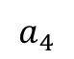
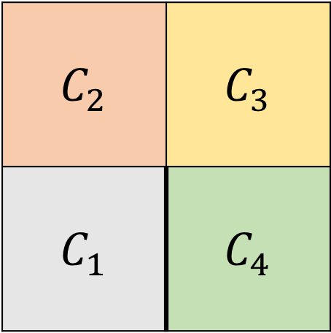
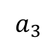
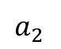
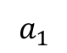
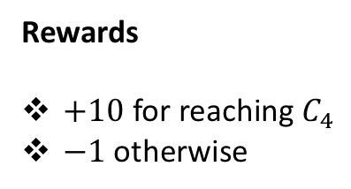
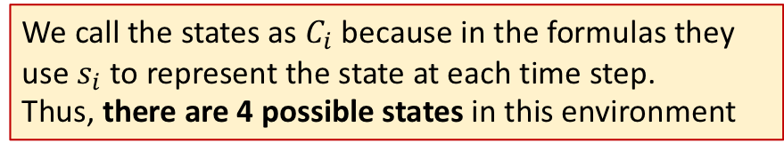
Environment Example
States
$$C_{2}$$ | $$C_{3}$$
$$C_{1}$$ | $$C_{4}$$
Actions
Rewards
$+10$ for reaching $C_{4}$
$−1$ otherwise
$$a_{1}$$
$$a_{2}$$
$$a_{3}$$
We call the states as $C_{i}$ because in the formulas they use $s_{i}$ to represent the state at each time step.
Thus, there are 4 possible states in this environment
$$a_{4}$$
Agent
Notes:
We call the states as $C_{i}$ because in the formulas they use $s_{i}$ to represent the state at each time step. But we want to make clear that there are 4 possible states in this environment

Slide 4
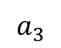
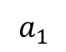
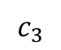
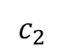
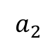
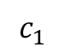
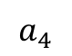
Environment Example
Table of values and Counter Table
$$a_{1}$$
$$a_{2}$$
$$a_{3}$$
$$a_{4}$$
$$c_{1}$$
$$c_{2}$$
$$c_{3}$$
X represents that if the agent takes that action, it will remain in the same cell in the next state
The Table of values is trying to answer the natural question:
which action is the best one at each state?
Counter Table is keeping track of how many time each state has been visited

Slide 5
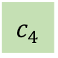
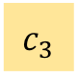
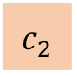
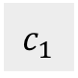
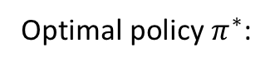
Environment Example
Optimal policy $π^{∗}$:
$$c_{1}$$
$$c_{2}$$
$$c_{3}$$
$$c_{4}$$
The agent has to find this policy by interacting with the environment
Notes:
We call the states as $C_{i}$ because in the formulas they use $s_{i}$ to represent the state at each time step. But we want to make clear that there are 4 possible states in this environment
X represents that if the agent takes that action, it will remain in the same cell in the next state

Slide 6
Temporal Difference Methods Do NOT need to run the entire episode to update the Q-Table Instead, we update every time step

Slide 7
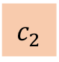
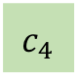
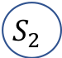
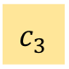
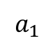
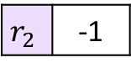
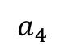
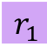
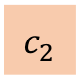
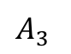
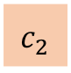
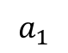
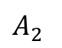
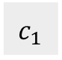
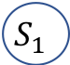
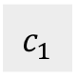
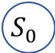
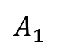
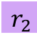
SARSA – SARSA(0)
Episode 1:
The Q-Table is initialized with all values set to 0
$$a_{1}$$
$$a_{4}$$
$$a_{1}$$
$$c_{1}$$
$$c_{2}$$
$$c_{2}$$
Not entire episode, just 1 time step ahead
$$c_{4}$$
Rewards
$$c_{3}$$
$$r_{2}$$ | -1
$$c_{2}$$
$$A_{2}$$
$$A_{3}$$
$$r_{1}$$
$$S_{1}$$
$$r_{2}$$
$$S_{2}$$
$$A_{1}$$
$$c_{1}$$
$$S_{0}$$
S A R S A

Slide 8
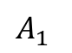
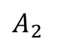
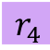
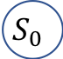
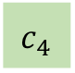
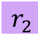
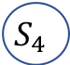
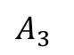
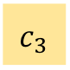
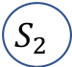
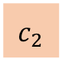
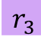






This was the Monte Carlo approach
$$c_{4}$$
$$G\left(S_{2}\right)=G_{2}=r_{3}+r_{4}=−1+10=9$$
$$S_{4}$$
General Update Rule: $Q\left(s_{t},a_{t+1}\right)$ = $r_{t+1}+G_{t+1}$
$$r_{4}$$
$$A_{4}$$
$$c_{3}$$
$$r_{3}$$
$$S_{3}$$
But we haven’t finished our episode:
We do NOT know the value of G
$$A_{3}$$
$$c_{2}$$
$$S_{1}$$
$$A_{2}$$
$$S_{2}$$
$$r_{1}$$
$$r_{2}$$
$$A_{1}$$
$$c_{1}$$
$$S_{0}$$

Slide 9









SARSA(0)
$Q$-Table
How do we update the table?
$$a_{1}$$
$$a_{2}$$
$$a_{3}$$
$$a_{4}$$
$$c_{4}$$
$$c_{1}$$
+7 | +6 | +5 | +6
+8 | +7 | +8 +7.84 | +9
+10 | +7 | +8 | +8
$$c_{2}$$
$$c_{3}$$
$$c_{3}$$
$$c_{2}$$
$$S_{1}$$
$$A_{2}$$
$$S_{2}$$
$$A_{3}$$
$$r_{1}$$
$$r_{2}$$
$$A_{1}$$
$$c_{1}$$
$$S_{0}$$
Update Rule: $Q\left(c_{2},a_{3}\right)$ = $Q\left(c_{2},a_{3}\right)+α\left(r_{2}+γQ\left(c_{2},a_{4}\right)−Q\left(c_{2},a_{3}\right)\right)=8+\frac{1}{5}\left(0+0.9∗8−8\right)=7.84$
General Update Rule: $Q\left(S_{t},A_{t}\right)$ = $Q\left(S_{t},A_{t}\right)+α\left(R_{t+1}+γQ\left(S_{t+1},A_{t+1}\right)−Q\left(S_{t},A_{t}\right)\right)=$
$Current+step_{size}∗(observed rewards+disctounted{ Q}_{next}−current$) =

Slide 10

The update in Sarsa is done after each transition from a non-terminal state

Slide 11

SARSAMAX – Q-Learning
How do we update the table?
Episode 1:
The Q-Table is initialized with all values set to 0
?
$$a_{1}$$
$$a_{4}$$
$$a_{1}$$
Update the policy before choosing next action
$$c_{1}$$
$$c_{2}$$
$$c_{2}$$
By choosing the action with the highest Q-value
$$c_{4}$$
Rewards
$$c_{3}$$
$$r_{2}$$ | -1
$$A_{3}$$
$$c_{2}$$
$$S_{1}$$
$$A_{2}$$
$$S_{2}$$
$$r_{1}$$
$$r_{2}$$
$$A_{1}$$
$$c_{1}$$
$$S_{0}$$
S A R S A Max

Slide 12
SARSAMAX – Q-Learning
$Q$-Table
How do we update the table?
$$a_{1}$$
$$a_{2}$$
$$a_{3}$$
$$a_{4}$$
$$c_{4}$$
$$c_{1}$$
+7 | +6 | +5 | +6
+8 | +7 | +8 +8.02 | +9
+10 | +7 | +8 | +8
$$c_{2}$$
$$c_{3}$$
$$c_{3}$$
$$A_{3}$$
$$c_{2}$$
$$S_{1}$$
$$A_{2}$$
$$S_{2}$$
$$r_{1}$$
$$r_{2}$$
$$A_{1}$$
$$c_{1}$$
$$S_{0}$$
Update Rule: $Q\left(c_{2},a_{3}\right)$ = $Q\left(c_{2},a_{3}\right)+α\left(r_{2}+γQ\left(c_{2},a_{4}\right)−Q\left(c_{2},a_{3}\right)\right)=8+\frac{1}{5}\left(8+0.9∗9−8\right)=8.02$
General Update Rule: $Q\left(S_{t},A_{t}\right)$ = $Q\left(S_{t},A_{t}\right)+α\left(R_{t+1}+γ\max_{a}Q\left(S_{t+1},a\right)−Q\left(S_{t},A_{t}\right)\right)=$
$Current+step_{size}∗(observed rewards+disctounted{ Q}_{of action that maximizes Q}−current$) =

Slide 13

The update in Sarsa pushes the values closer to evaluating whatever the $ε$-greedy policy is currently following
ON-POLICY
The update in Sarsamax directly attempts to approximate the optimal value function at every time step
OFF-POLICY

Slide 14


Expected SARSA
Episode 1:
The Q-Table is initialized with all values set to 0
?
$$a_{1}$$
$$a_{4}$$
$$a_{1}$$
Also update the policy before choosing next action
$$c_{1}$$
$$c_{2}$$
$$c_{2}$$
Takes into account all actions and its probabilities
$$c_{4}$$
Rewards
$$c_{3}$$
$$r_{2}$$ | -1
$$c_{2}$$
$$S_{1}$$
$$A_{2}$$
$$S_{2}$$
$$r_{1}$$
$$r_{2}$$
$$A_{1}$$
$$c_{1}$$
$$S_{0}$$
$$A_{3}$$
S A R S A
Expected $π\left(a_{i}|s\right)$

Slide 15



Expected SARSA
$Q$-Table
How do we update the table?
$$a_{1}$$
$$a_{2}$$
$$a_{3}$$
$$a_{4}$$
$$c_{4}$$
$$c_{1}$$
+7 | +6 | +5 | +6
+8 | +7 | +8 +8.02 | +9
+10 | +7 | +8 | +8
$$c_{2}$$
$$A_{3}$$
$$c_{3}$$
$$c_{3}$$
$$c_{2}$$
$$S_{1}$$
$$A_{2}$$
$$S_{2}$$
$$r_{1}$$
$$r_{2}$$
$$A_{1}$$
$$c_{1}$$
$$S_{0}$$
Update Rule: $Q\left(c_{2},a_{3}\right)$ = $Q\left(c_{2},a_{3}\right)+α\left(r_{2}+γ\left\{π\left(a_{1}|s\right)Q\left(c_{3},a_{1}\right)+π\left(a_{2}|s\right)Q\left(c_{3},a_{2}\right)+π\left(a_{3}|s\right)Q\left(c_{3},a_{3}\right)+π\left(a_{4}|s\right)Q\left(c_{3},a_{4}\right)\right\}−Q\left(c_{2},a_{3}\right)\right)=$
General Update Rule: $Q\left(S_{t},A_{t}\right)$ = $Q\left(S_{t},A_{t}\right)+α\left(R_{t+1}−γ\sum_{a}{π\left(a|s\right)}{Q\left(S_{t+1},a\right)−Q\left(S_{t},A_{t}\right)}\right)=$
$Current+step_{size}∗(observed rewards+disctounted weighted average ofQ_{next} −current$) =

